Slide 1
Code stuff
By: Kevin Vazquez

Slide 2
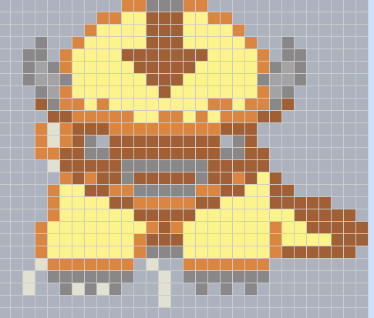
First Pixel Art
I used Appa from avatar as my inspiration for this project this was easy in that the hardest thing I had to do was counting where I was putting my squares.

Slide 3
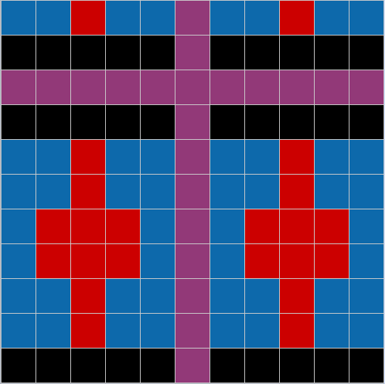
Pattern that Repeats
In this pattern we had to use shapes that were already given to us and create a pattern that repeats from end to end of our given space.

Slide 4

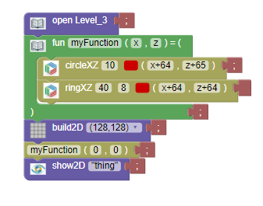
Target Pattern
This pattern was for the Real image project and I mostly used the level 3 circle and ring lines since as you can see I only needed the them since I choose the target logo for my project.

Slide 5
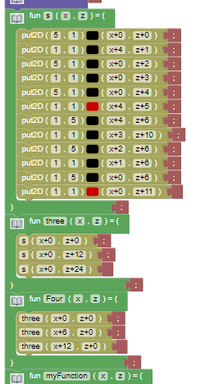
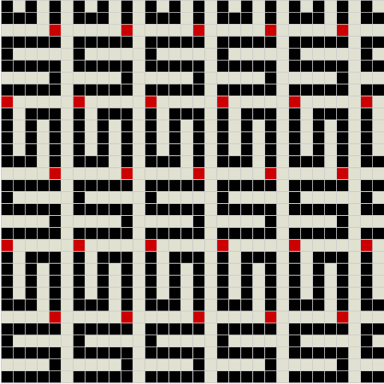
Repeating Pattern.
The S Repeating pattern was just making an s patern then copy pasting it over and over again the hardest part was just figuring out how much to move it for in the X+ and z+.

